Slide 1
Christianity and/or Science:
A Singaporean perspective
Kuin Tian Pang (Zach)
PhD candidate in Bioengineering
Imperial College London

Slide 2
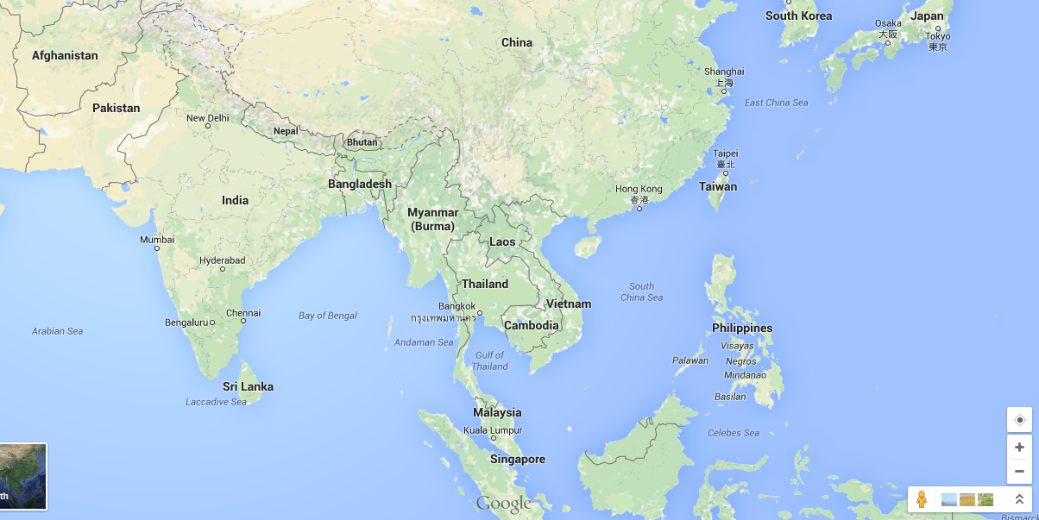





Introduction - Singapore
Population:
5.6 million residents
Ethnicity:
74.1% Chinese
13.4% Malay
9.2% Indian
3.3% Others

Slide 3
Introduction – Science in Singapore
“our population ... is the one thing we have which makes up for our lack of size and numbers, and it is of the utmost importance that, in the field of science and technology, we should lead the field in this part of the world. “
Late Founding Prime Minister Lee Kuan Yew

Slide 4
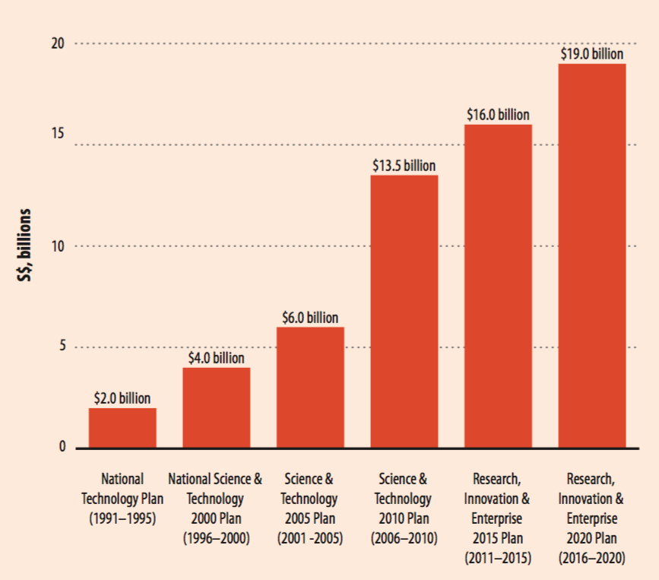
Introduction – Science in Singapore
“R&D is an investment in our own future. It’s an expression of belief in Singapore and Singapore’s future. If we want to be a knowledge-based economy, which thrives on innovation and enterprise, we must build this knowledge base on which we can build the future of Singapore – then R&D is where we have to invest.”
Deputy Prime Minister of Singapore

Slide 5
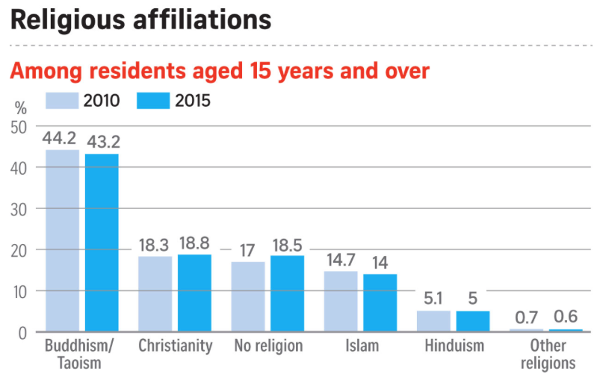
Introduction – Religion in Singapore
Secular state
Religious freedom
Religiously diverse
No speech or action that the government deems could affect religions harmony
Notes:
Singapore is a secular state, to guarantee secular pluralism. Secular not one that is free from religion, instead, one that ensures religious space are protected and that no single faith becomes overly dominant in term of political and ideological power.
Maintenance of Religious harmony act
tremendous care, effort and pre-emptive prudence invested in nurturing multi-religiosity as an integral part of singapore’s multi-racialism framework.

Slide 6
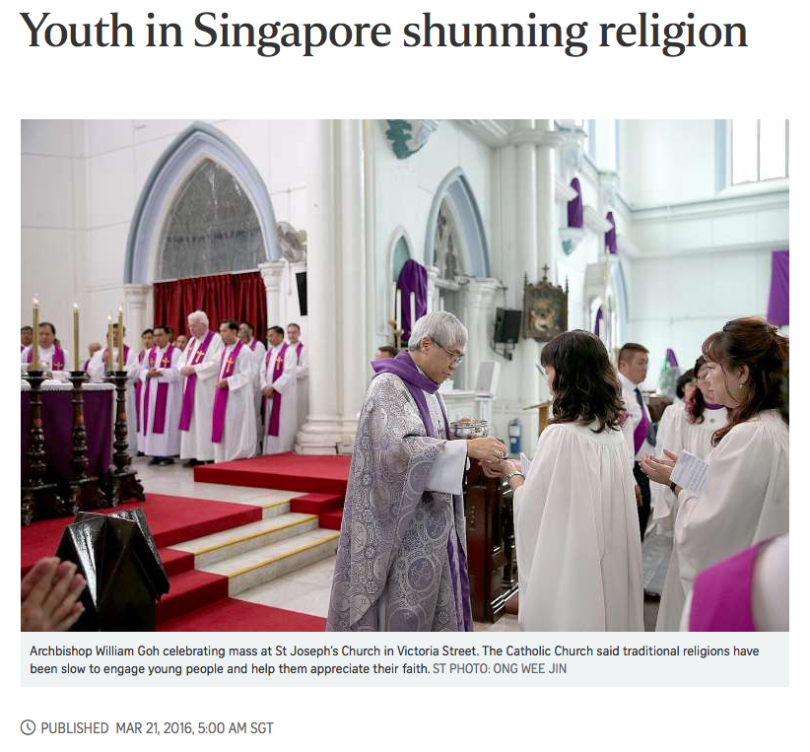
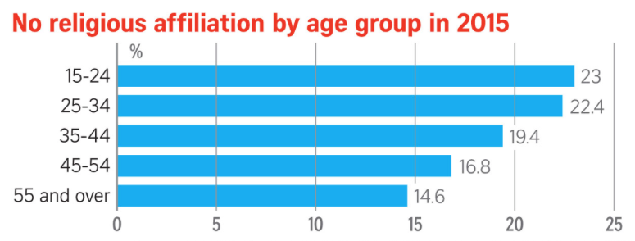
Introduction – Religion in Singapore
“I don't think I need divine guidance to make a right or wrong decision. Reason alone can guide such decision- making.”
Bertrand Seah, 21. He grew up Christian in a Methodist school environment, but began doing his own research on religion in junior college. He became influenced by religious critics and scientific skepticism advocates such as American Sam Harris.
‘This group might therefore find religions "variously limiting, irrational, oppressive, unreasonable and unscientific.”’
Social anthropologist Lai Ah Eng of the National University of Singapore (NUS)

Slide 7
Case study – Theory of Evolution a deception from devil?
A megachurch’s pastor in Singapore gave a sermon titled ‘The Deception of Darwinism’
Don't let anyone capture you with empty philosophies and high-sounding nonsense that come from human thinking and from the spiritual powers of this world, rather than from Christ.
Colossians 2:8
“Darwinism is a high sounding nonsense”
-the megachurch’s pastor
The church’s Facebook group posted the sermon’s trailer
The same trailer was also shared by a popular Facebook group
The trailer (from both sources) was widely shared by other users
Attitudes of those who shared the post were analyzed and coded
Negative
  Sarcasm
  Rejection
  Attack
Neutral
  Sharing/No comment
  Promotion
  Show interest
Positive
  Supportive

Slide 8
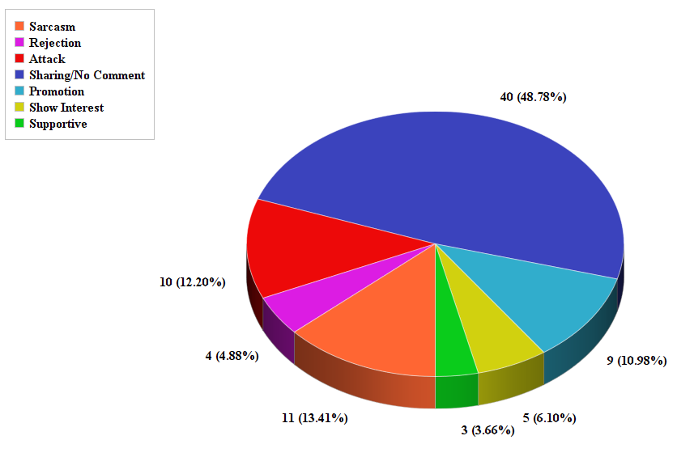
Viewers attitude towards the trailer shared on the church FB page
Negative
Neutral
Positive
82 out of 322 shares analyzed

Slide 9
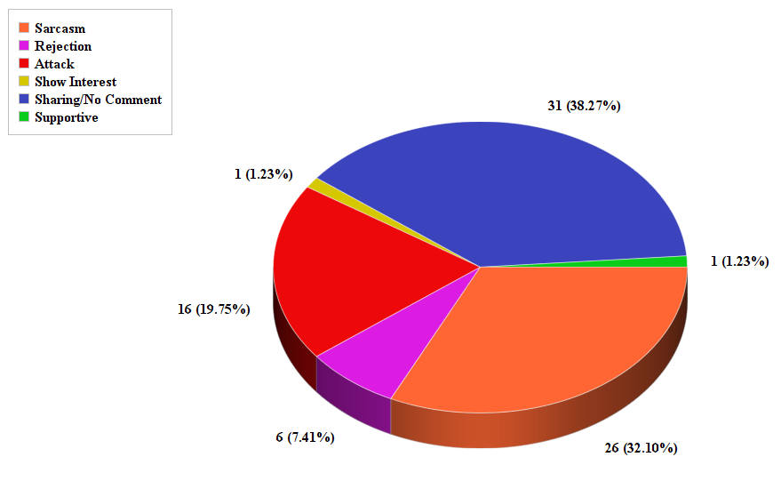
Viewers attitude towards the trailer repost by a popular FB page
Negative
Neutral
Positive
81 out of 272 shares analyzed

Slide 10
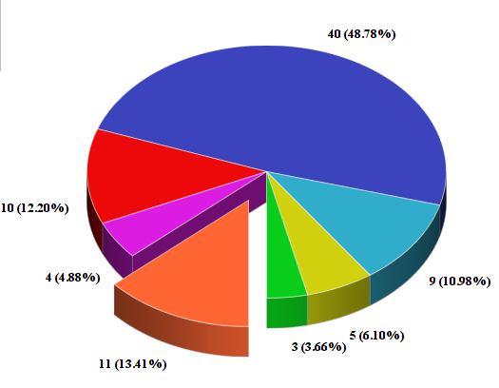
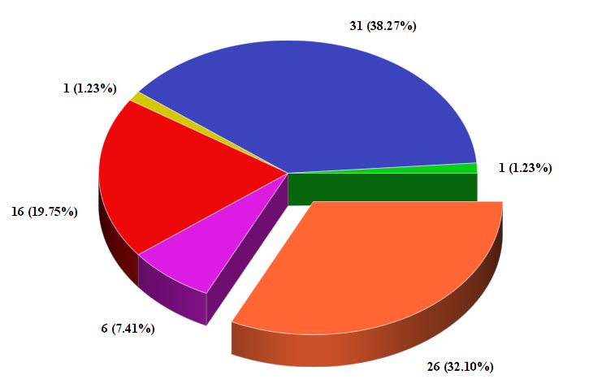
Viewers Attitude - Sarcasm
“By the end of the video, I was in stitches from all the ROTFLOL.”
The church FB post
“Yeah, evolution is fake. Decades upon decades of research and observation is nothing compared to your word. While I'm not religious, I believe to an extent that creationism and evolution can go hand in hand. The difference is that evolution has actual, tangible evidence and isn't reliant on faith alone.
This guy here begs to differ. He's a bad joke that won't stop…”
Repost by a FB page

Slide 11
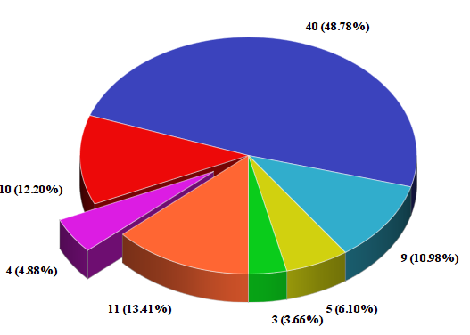
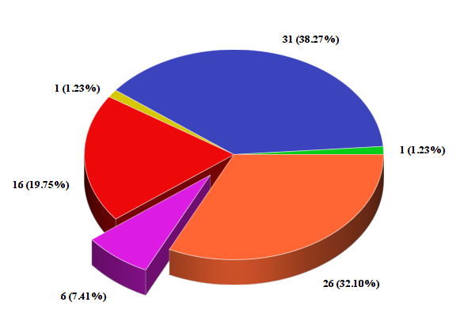
Viewers Attitude – Rejection of idea
“"Hardly any evidence for evolution," . Another small proof towards the view that religion and science don't mix ..”
“With the outreach that these group can depend on, I guess we on the other side should be more proactive in fighting for the defense of secularism in the public sphere”
The church FB post
“More imported right wing Christian fundamentalism to polarise Singapore”
Repost by a FB page

Slide 12
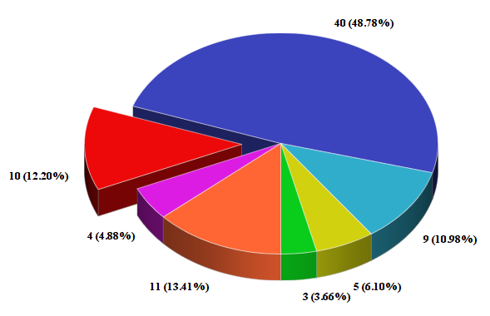
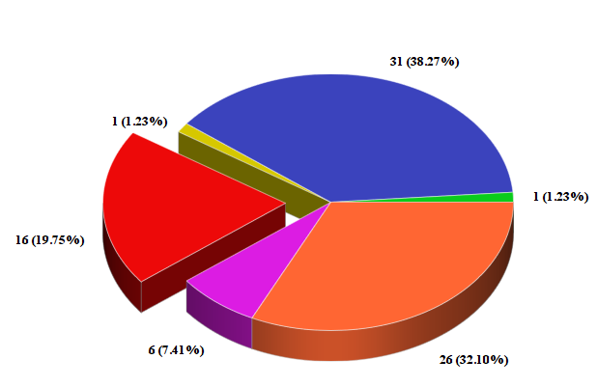
Viewers Attitude – Attack
”Stunning ignorance”
“Idiocy has come to Singapore”
The church FB post
“Narrow-mindedness because he needs more converts for his megachurch”
“Devolutionary biologist and his ideas on creationism. Side note, anyone interested to hear what he has to say...?”
Repost by a FB page

Slide 13
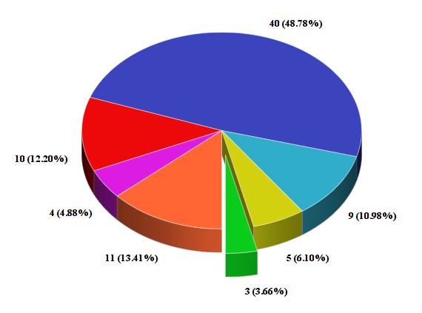
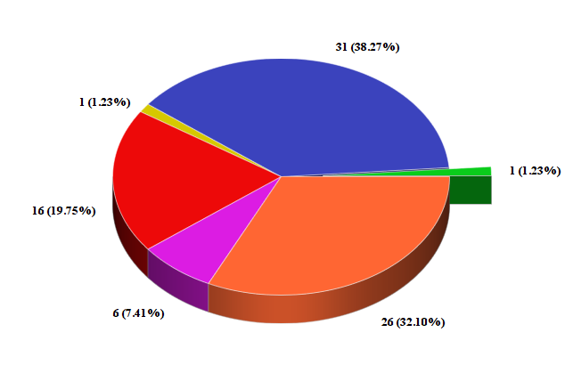
Viewers Attitude – Supportive
“It's good that there's an opportunity for the predominantly young congregation of [the church] to learn the arguments for Creationism. This will help them debunk evolution, which is merely a theory disguised as scientific truth. If a theory could be taught in schools because it seems plausible, then Creationism should also be taught given the many plausible arguments for it. Teaching it does not necessarily mean promoting any specific religious faith. Creationism only posits the existence of a Creator.”
The church FB post
Repost by a FB page
“Agreed, evolution is not proven scientifically”

Slide 14
Conclusion
We need more dialogue between science and faith(Christianity)
A need to create awareness that science and faith are not incompatible
Christians should embrace science and use it as a tool to be a witness for Jesus Christ
The fear of the Lord is the beginning of wisdom,
and knowledge of the Holy One is understanding.
Proverbs 9:10
The love of Christ, not science, leads us to the salvation of God;
But let us be careful not to push people away from God by our misinterpretation of God’s creation.

Slide 15


Acknowledgement
Pei Wen Law
MRes candidate in Educational and Social Research,
Institute of Education, UOL
Benjamin T.E. Ho
PhD candidate in International Relations,
London School of Economic and Political Science
OCCA Doctoral Fellow (2015-16)

